Slide 1

WELCOME

Slide 2


TEAM MEMBERS
Mst Tamanna Jannat
Sharifuzzaman Hasan
Nashit Hossain Emon
Md. Mahabub Alam

Slide 3




SkillSage
Connecting Companies with
Expert Freelance Examiners

Slide 4


Introduction
SkillSage is an innovative platform designed to bridge the gap between companies and freelance examiners, revolutionizing the way businesses assess the skills and competencies of job seekers

Slide 5


v
s
Limited Scalability
Expert Examineers
Time-Consuming
Efficiency & Flexibility
Bias Risk
Objective Evaluations

Slide 6





Get Potential candidates
I want a
developer
Selecet Examinners &
make a schedule

Slide 7




1
2
3
Get Expert Examiners
Make Schedule
Experts
will take the exam
4
Get potential candidate for you
ONLY FEW STEPS BEHIND

Slide 8


Key Features
01
02
03
04
Expert Examiner Network
Smart Matching System
User-Friendly Interface
Assessment Quality

Slide 9




We are using
Frontend
React-based user interface providing a dynamic and responsive user experience
Technology
Backend
Node.js and Express.js for managing application logic, APIs, and server-side operations.
Database
Socket.IO Server
MongoDB for storing user profiles, assessments, and other data in a scalable and flexible NoSQL database.
Manages real-time communication, enabling features such as live updates, notifications, and chat functionality

Slide 10
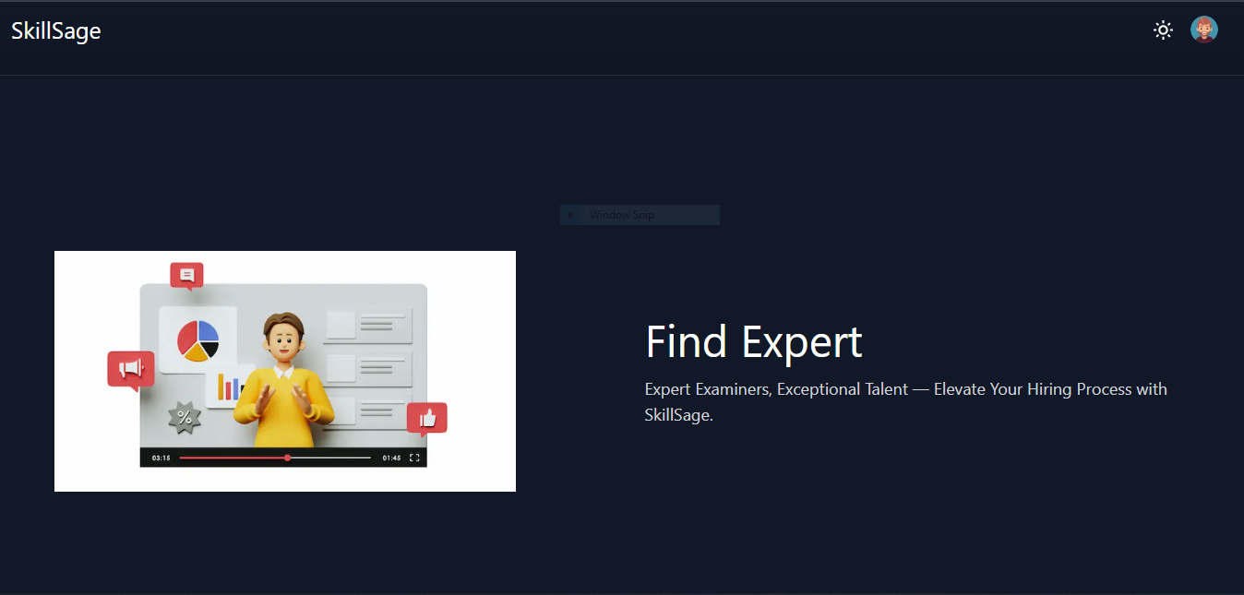
Some User Interface of SkillSage

Slide 11
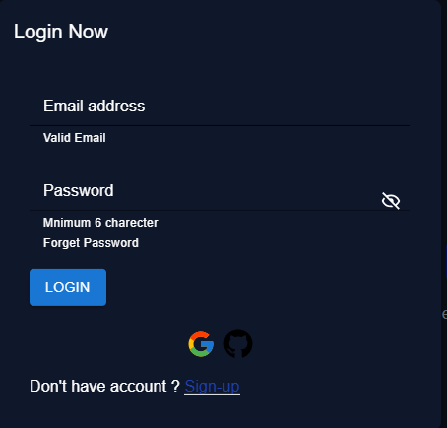
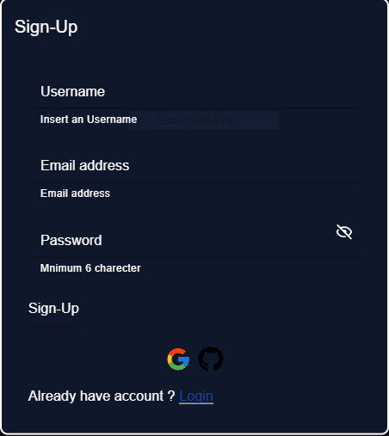
User authentication module

Slide 12
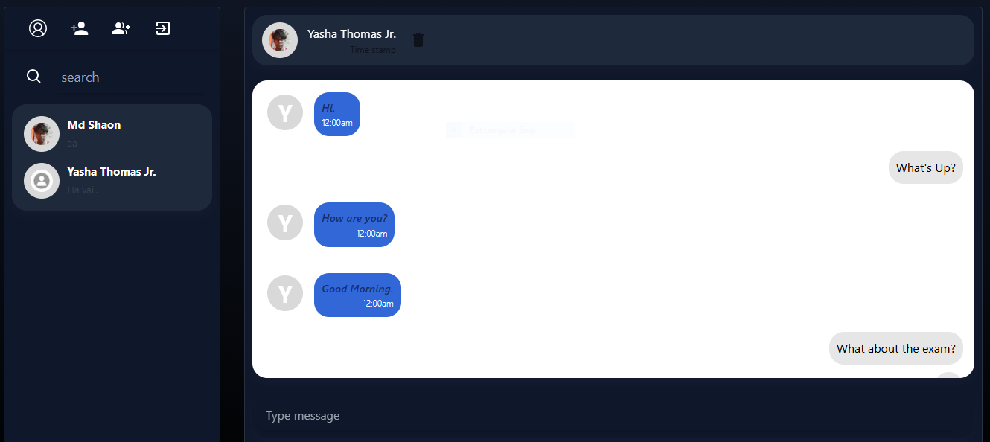
Conversation with examiner

Slide 13
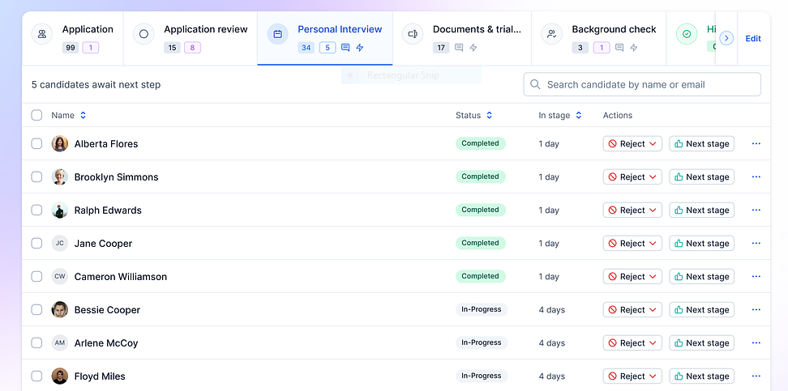
Find the desired candidates

Slide 14
Five key benefits that SkillSage offers to the job industry
Streamlined Hiring Process
Enhanced Candidate Evaluation
Flexible and Scalable Solution
Cost-Effective Expertise
Quality Feedback for Long-Term Success

Slide 15

MAIN
GOAL
SkillSage platform represents a significant advancement in the recruitment industry by addressing the limitations of traditional assessment methods

Slide 16

Thank You
for your attention

